Slide 1
W7 Market Segment
Professional Services Organisations

Slide 2
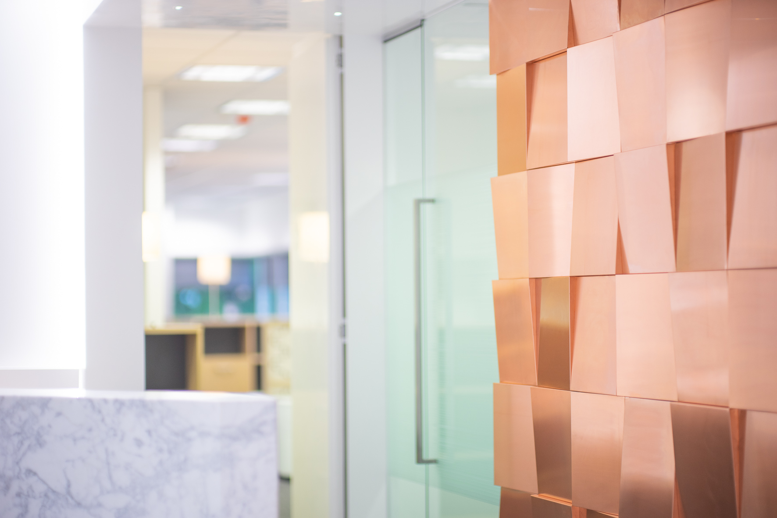
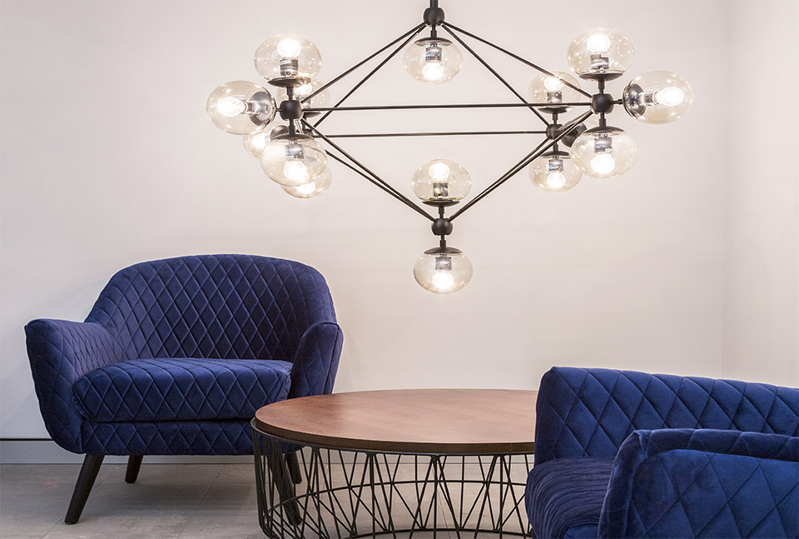
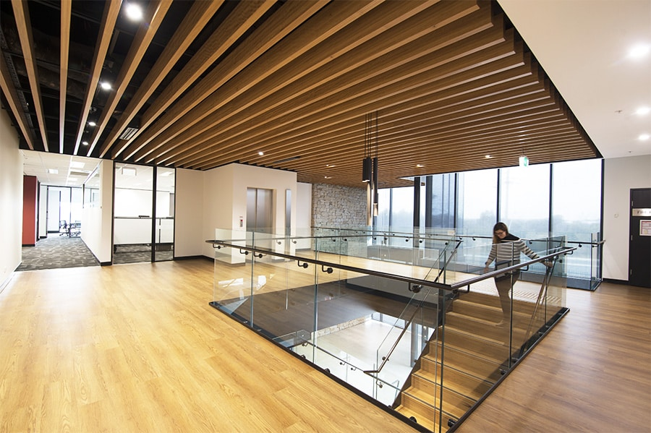
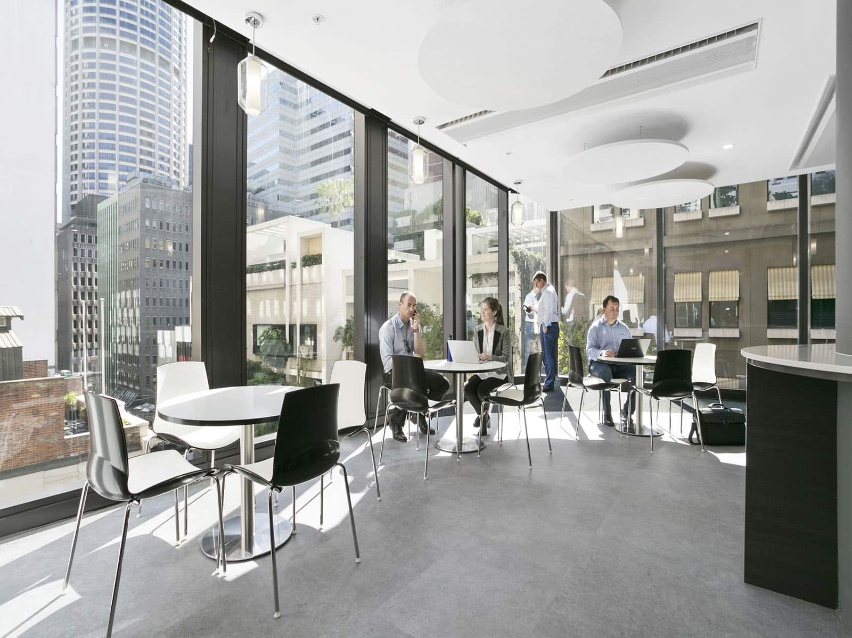
OFFICE TRANSFORMATIONS
Melbourne • Sydney Perth • Brisbane
30% FASTER
10% MORE COST SAVINGS

Slide 3
About Wurkspace 7
Wurkspace 7 is an architecturally driven Workspace Design & Consultancy firm backed by a highly skilled in-house construction team.
A leader in its field, Wurkspace 7 engages with clients nationally to optimise workplaces and together create centres for organisational advancement and transformation.
Wurkspace 7 Corporate Transformations was established as the convergence of specialist workspace designers and strategic consultants passionate about revolutionising the future of office environments.
Our signature project delivery approach provides clients with best global practices in office architecture and workplace strategy, resulting in the delivery of truly compelling workspaces.

Slide 4
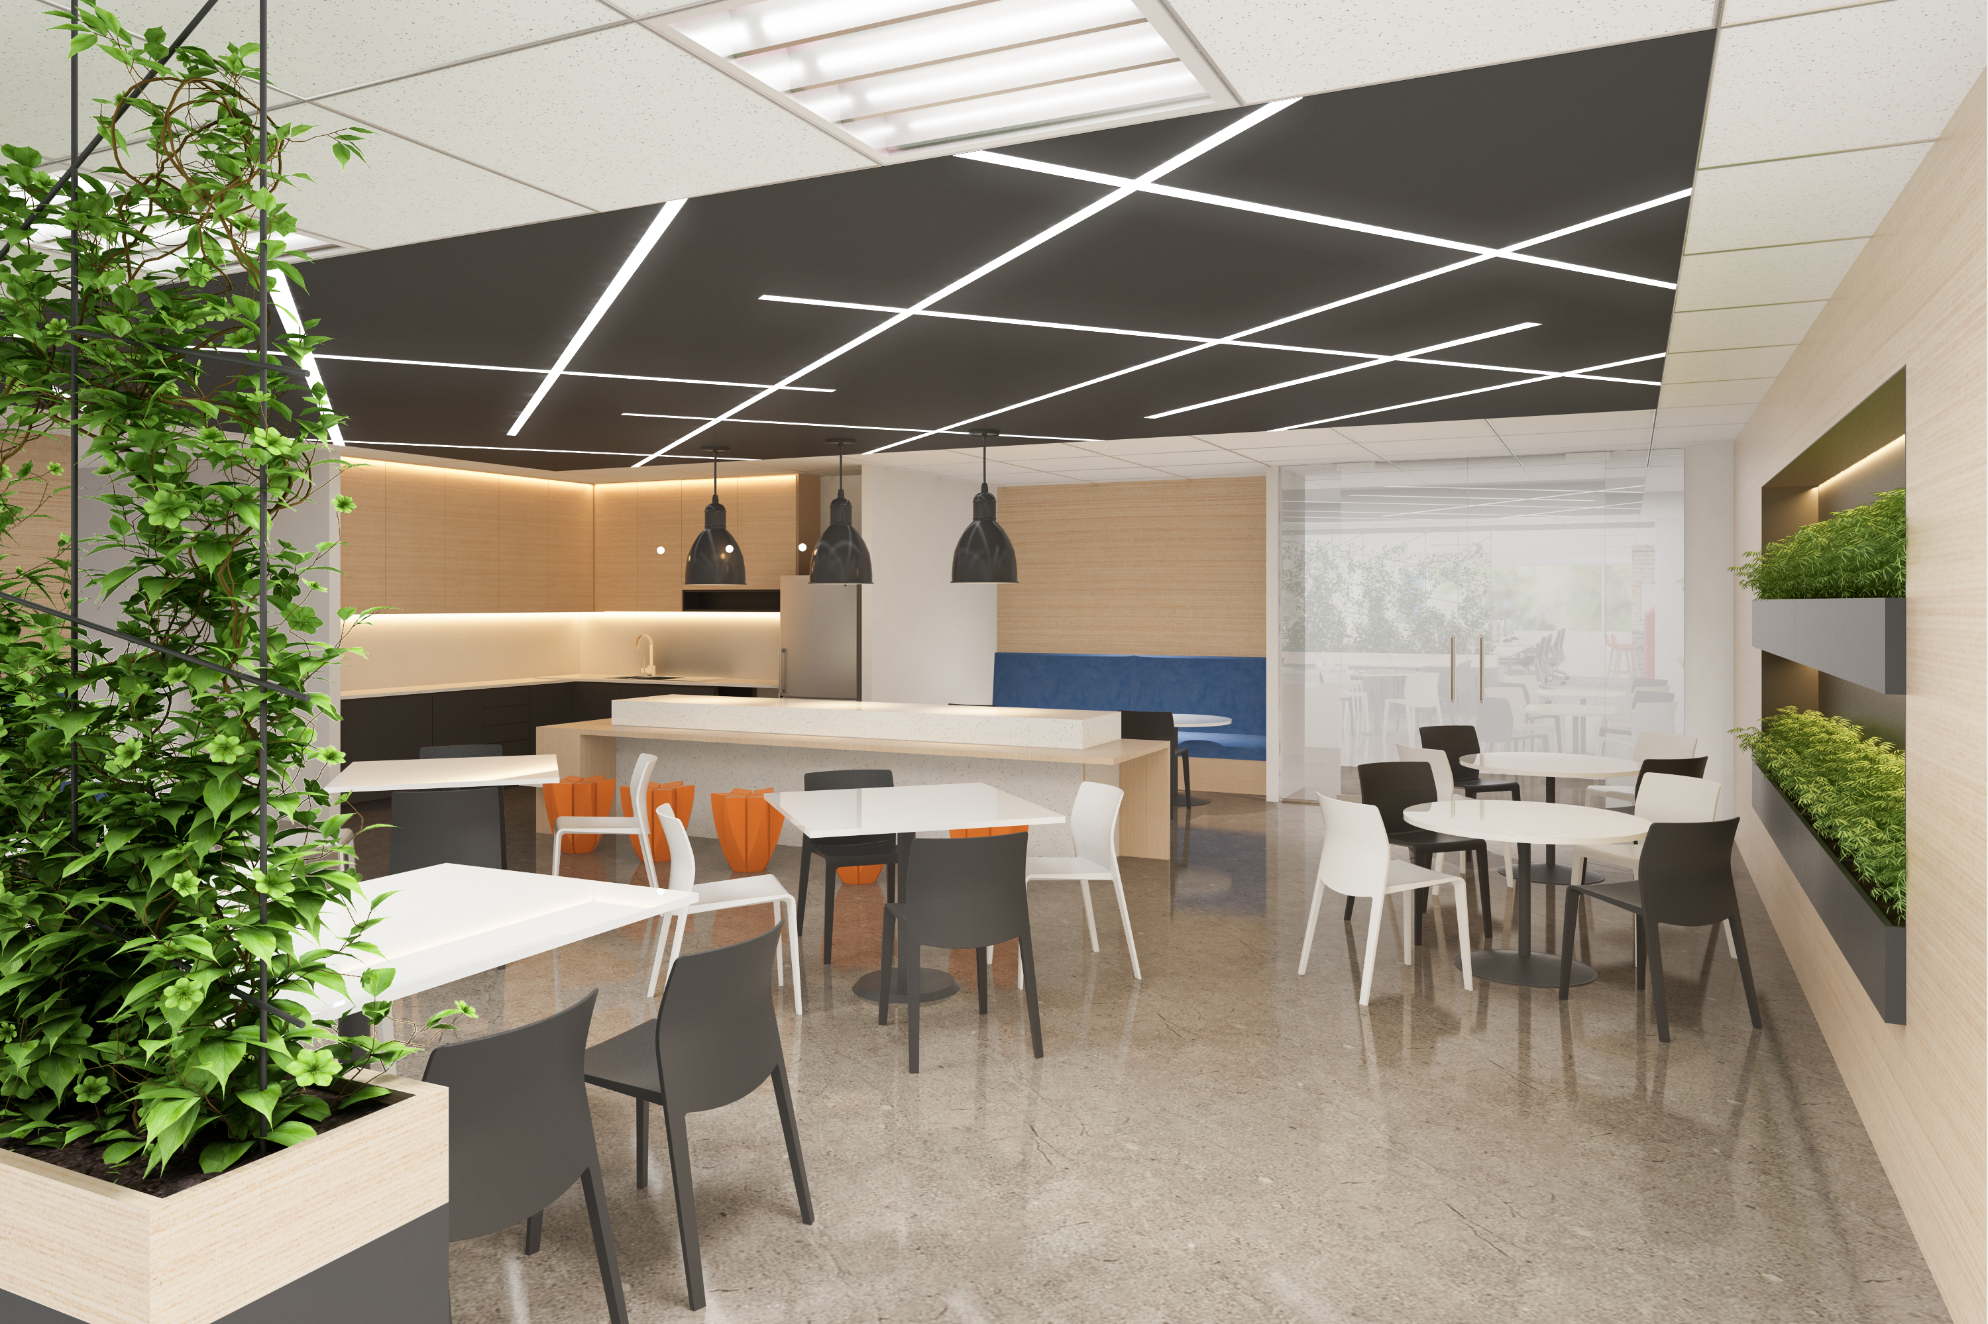
At Wurkspace7,
our process is simple, tangible, and 3-D
Discover
Design
Deliver

Slide 5
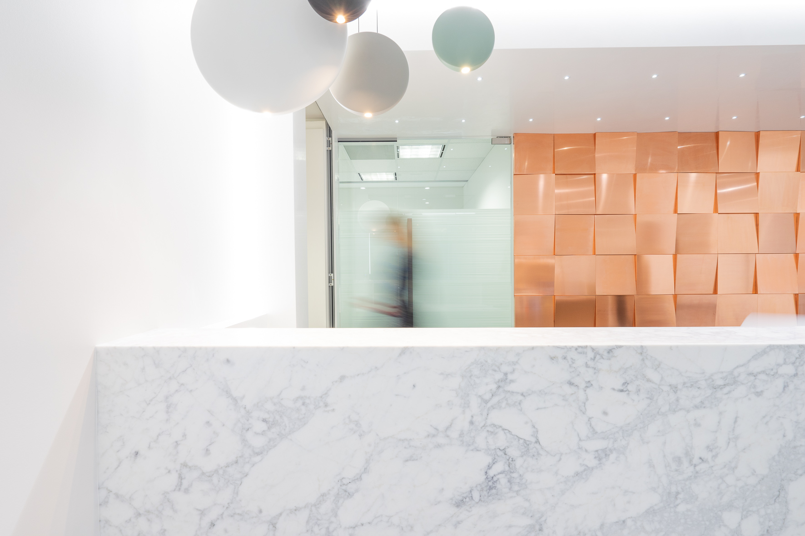
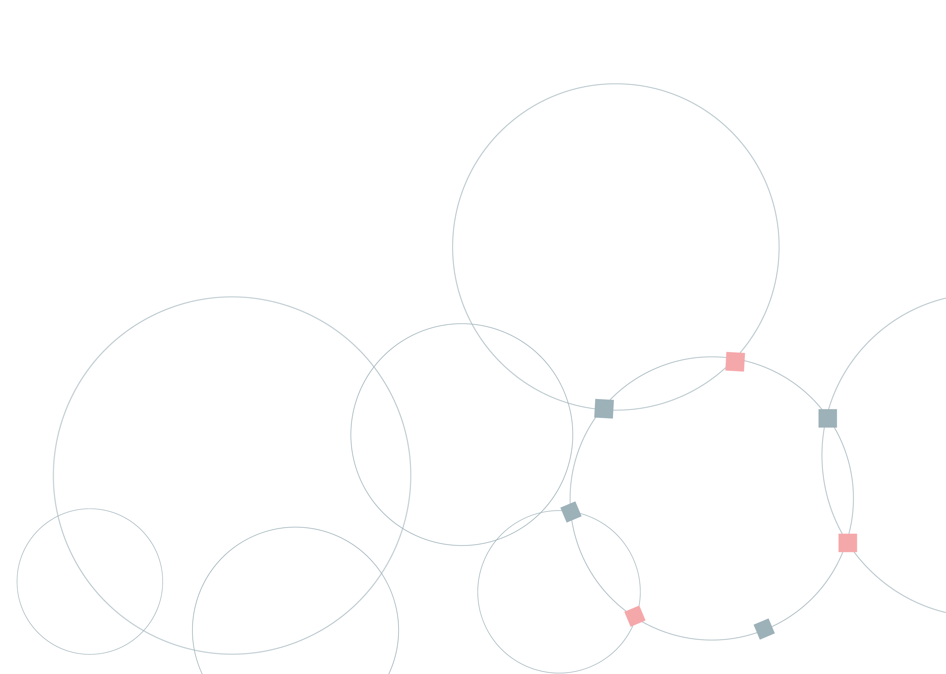

Professional Services Organisations
Wurkspace 7 understands the office fitout and space planning requirements unique to professional services organisations such as Accountants, Financial Planners, Investment Equity firms, IT companies, Insurance companies, Legal firms and Management Consultants.
As a professional organisation, you value your privacy and confidentiality and require an environment free from distractions. You also need an efficiently designed workspace to counter the costs of securing premier rental space.
Wurkspace 7 understands your needs and has helped many organisations like yours to identify and leverage their space potential through our team of skilled and experienced designers.
So if you are looking at renovating or relocating, speak to the Australian specialist in design and construct.
Look at the recent transformations Wurkspace 7 has delivered for:
Lockton
Zenitas
WAPU
Gallagher
Resource Capital WAPU

Slide 6
Professional Services
Organisations
Case Study: Lockton Sydney

Slide 7
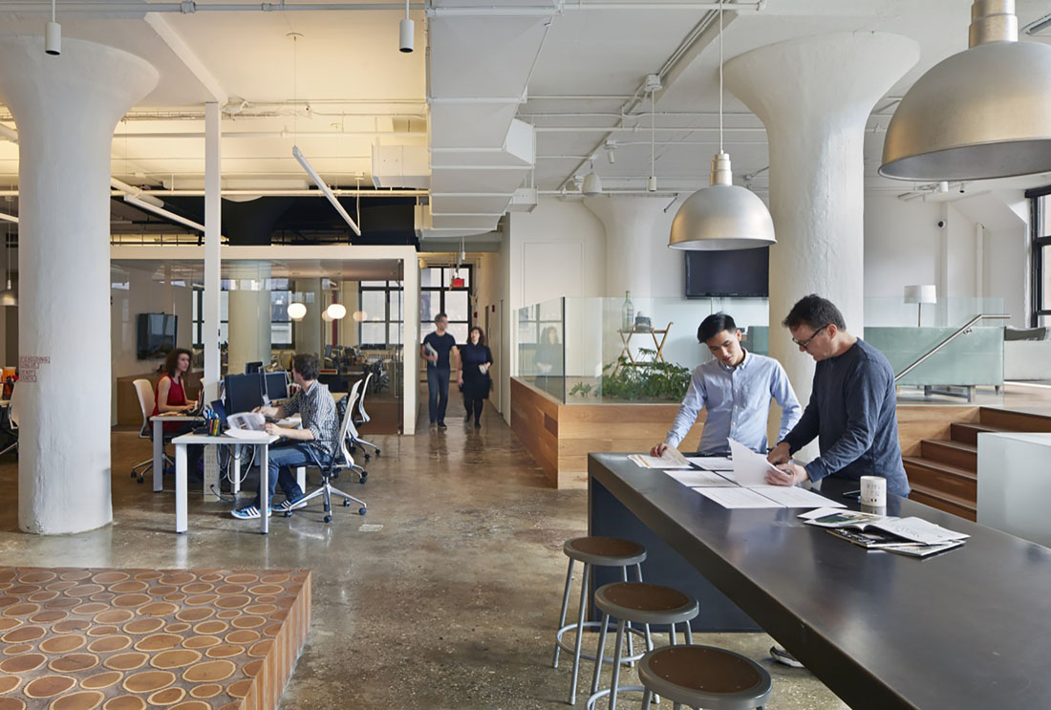

Project Concept
The challenge for Wurkspace 7, was to create a culture driven environment considering the smaller relative spatial footprint and on a tight timeline and budget.
SCOPE OF WORKS
Full design services with 3-D visual modelling
new plaster and feature glass walling
feature carpets and lighting
joinery and furniture works including full bar
built-in reception and kitchen
desking systems and seating

Slide 8
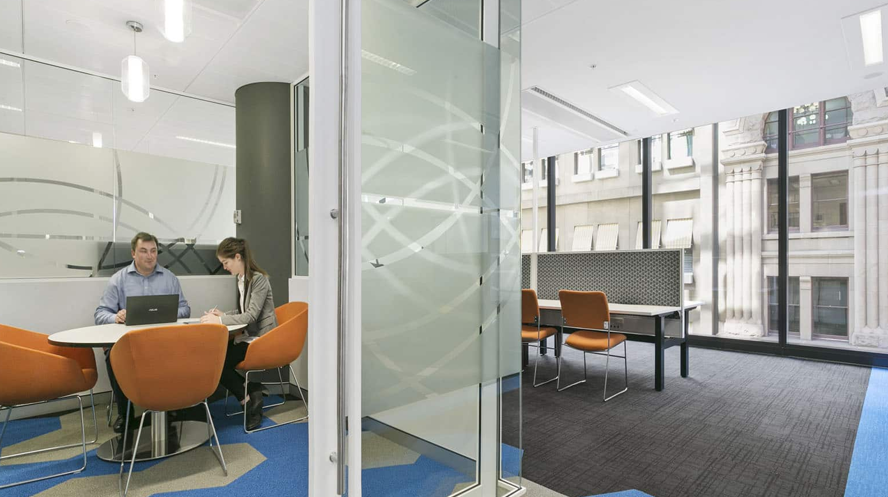
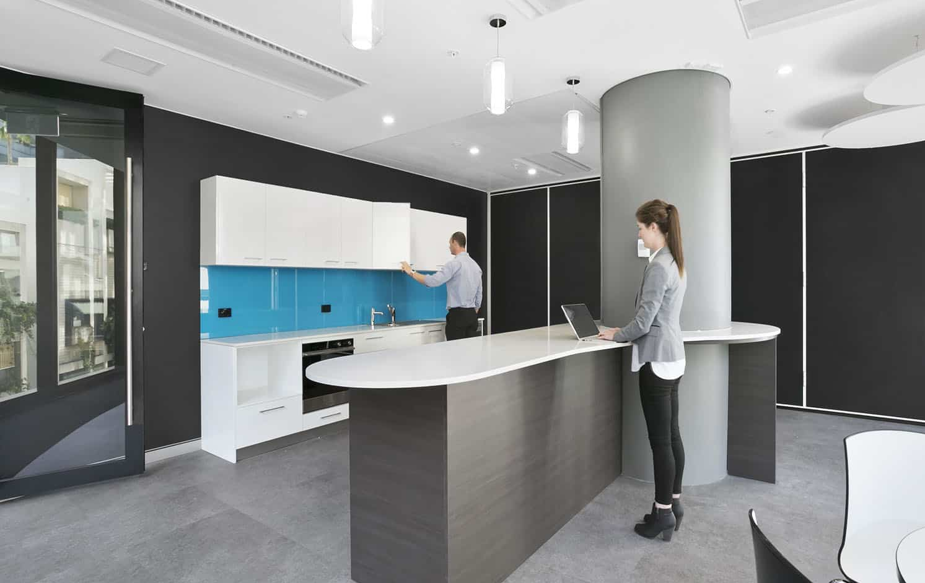
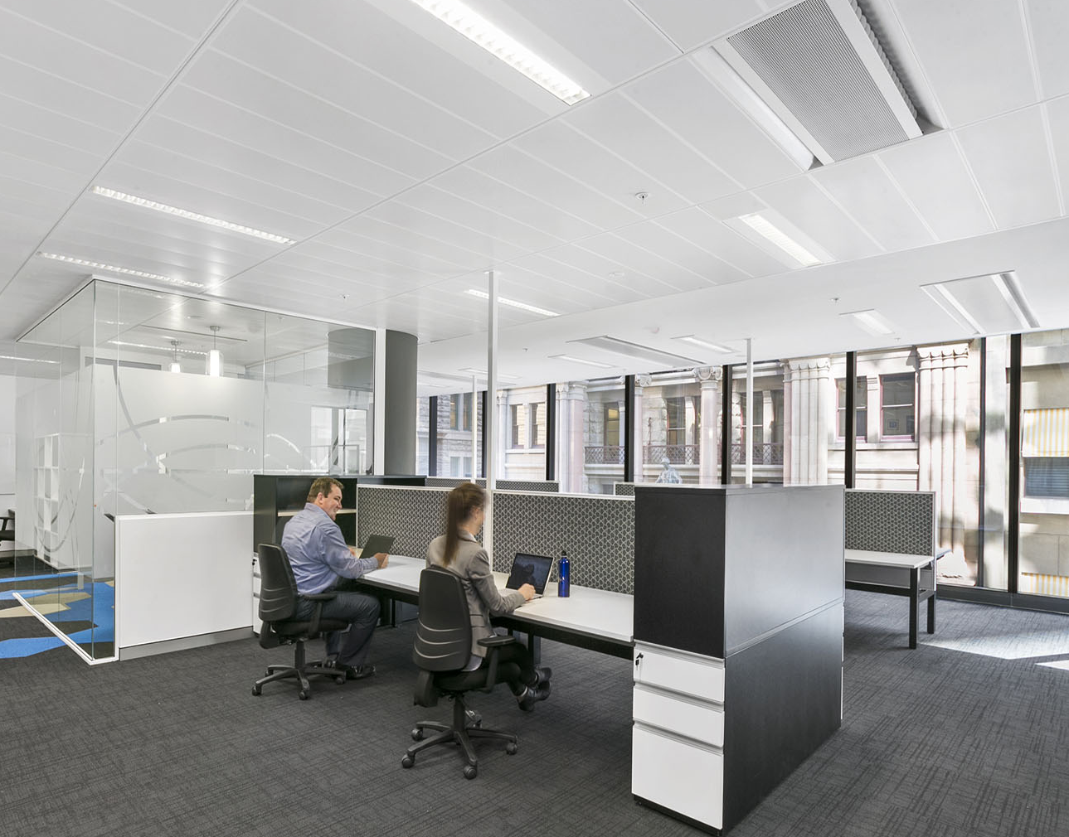

Project Completion
Lockton Group
Floor Area: 400m²
Industry: Insurance

Slide 9
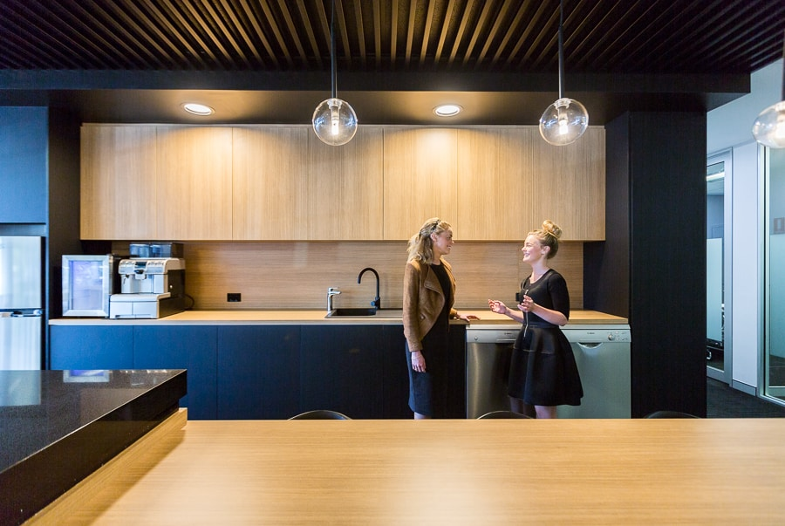
Understanding
people + work + space

Slide 10
Professional Services
Organisations
Case Study: Zenitas

Slide 11
Project Concept
After coming from a humble beginning, and thriving throughout the past five years, Zenitas presented Wurkspace 7 with the need of creating an open and human-centric space, in which reflected a holistic perspective whilst remaining anti-bureaucratic, friendly and simple.
SCOPE OF WORKS
development of open human-centric spaces
honest, natural materials a neutral colour palette and residential accents

Slide 12
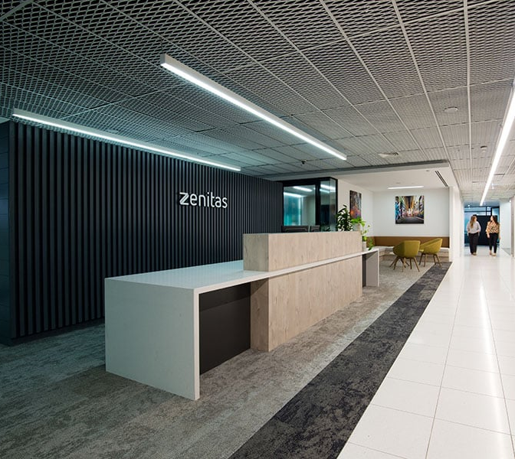
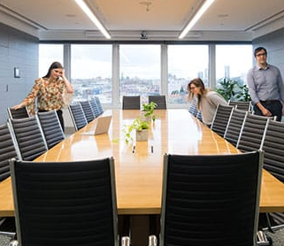
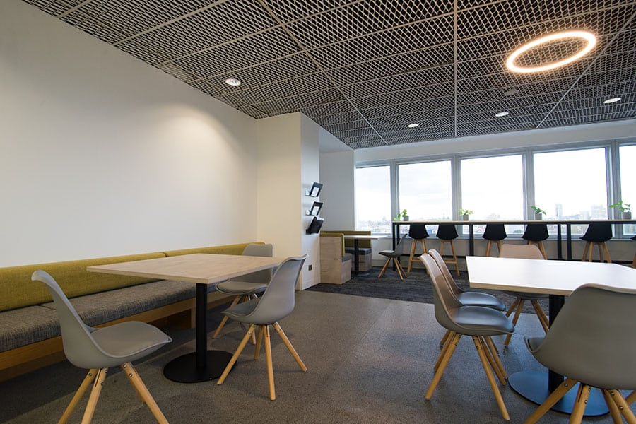

Project Completion
Zenitas
Floor Area: 1500m²
Industry: Healthcare Provider

Slide 13
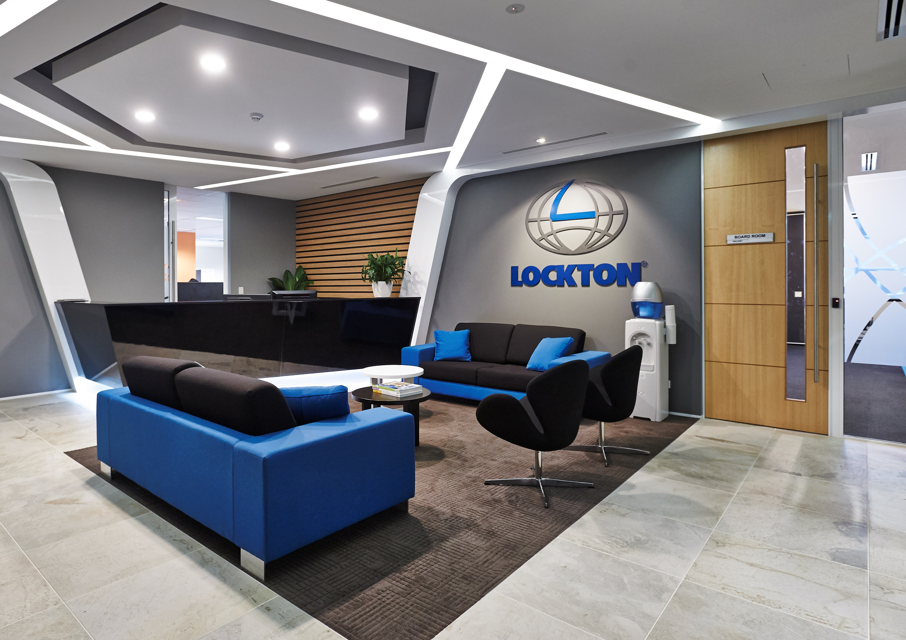
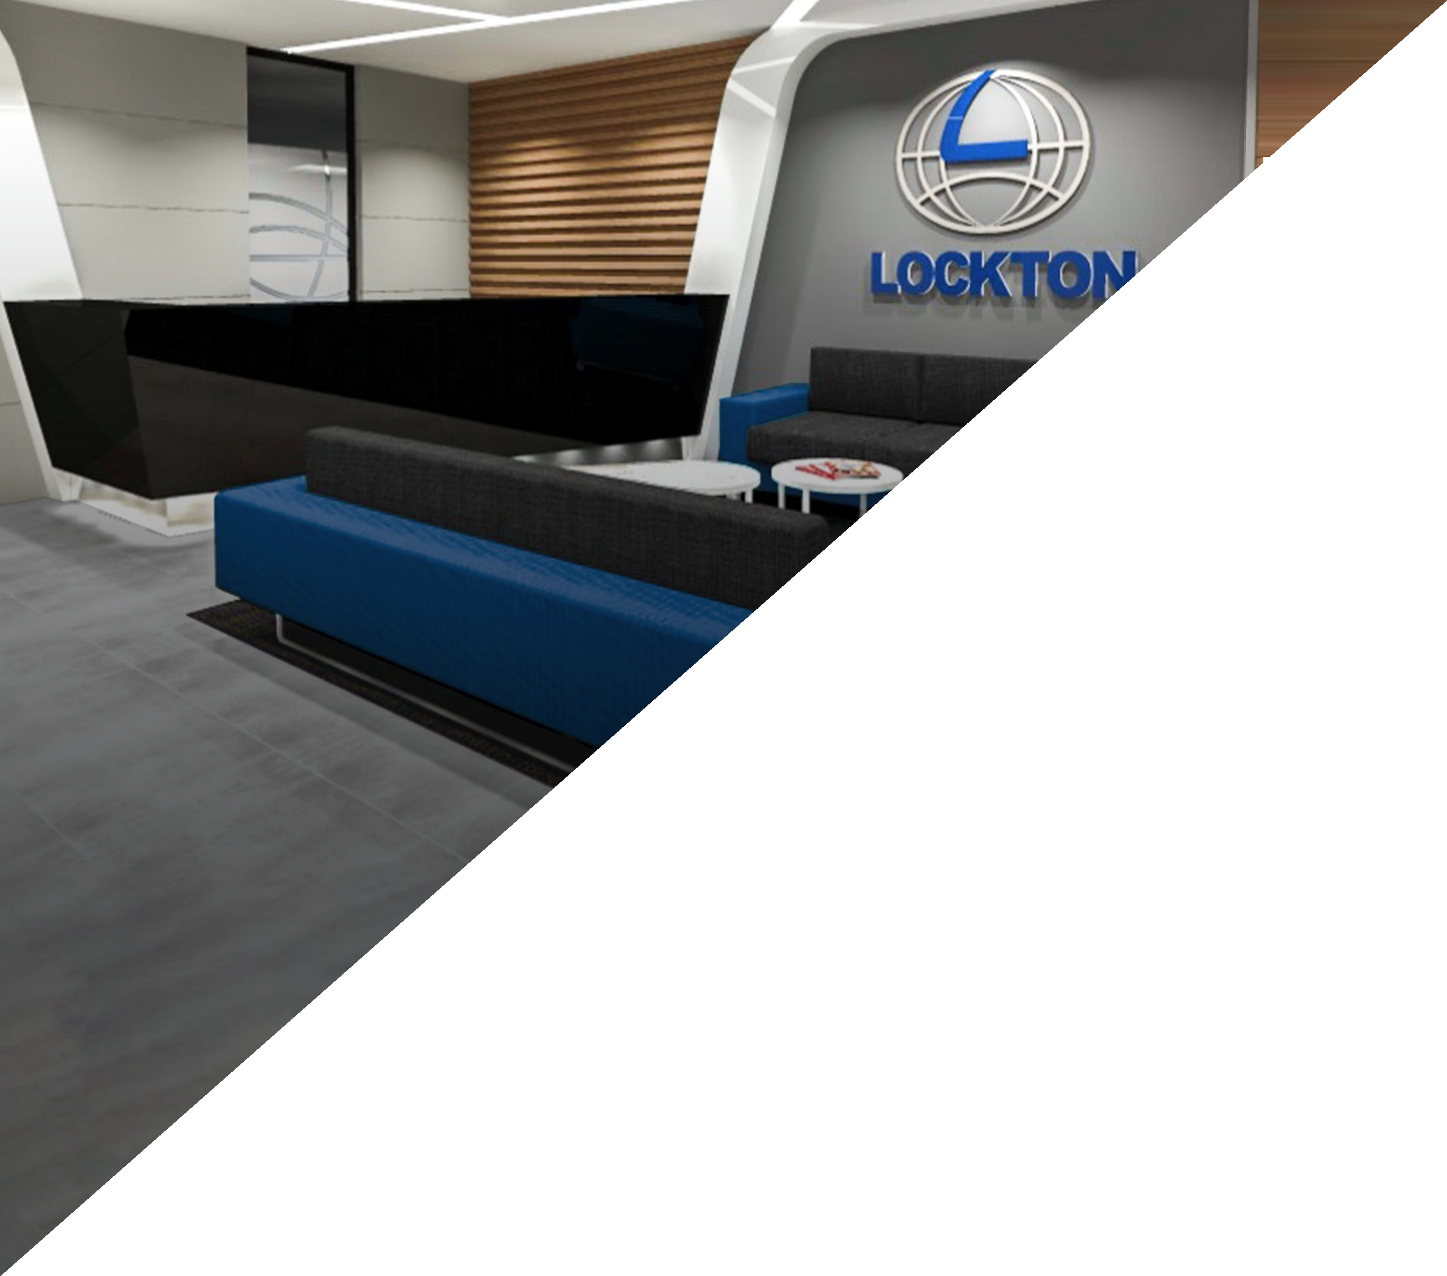
From Concept
Using the latest in 3D modelling Wurkspace 7 can show you the outcome in photo realistic colour before a single hammer is lifted.
This service provides a sense of spatial awareness unrivalled by other means. guaranteeing your satisfaction in the completed project.
Down to the most intricate details, like conceptualising intra-office line of sight, or visualising the sun projecting into your workspace, our skilled designers turn your vision into reality right before your eyes.
To Completion
With up to 70% of project costs determined in the design phase, Wurkspace 7 understands the value of starting with the end in mind.
Therefore, rooted in years of relevant experience, our Project Critical Path™ has been designed to ensure every corporate project follows its optimal pathway, in order to achieve success.
By designing with the end in mind, we ensure nothing of value is overlooked, omitted or discarded.

Slide 14
Completed Projects

Slide 15
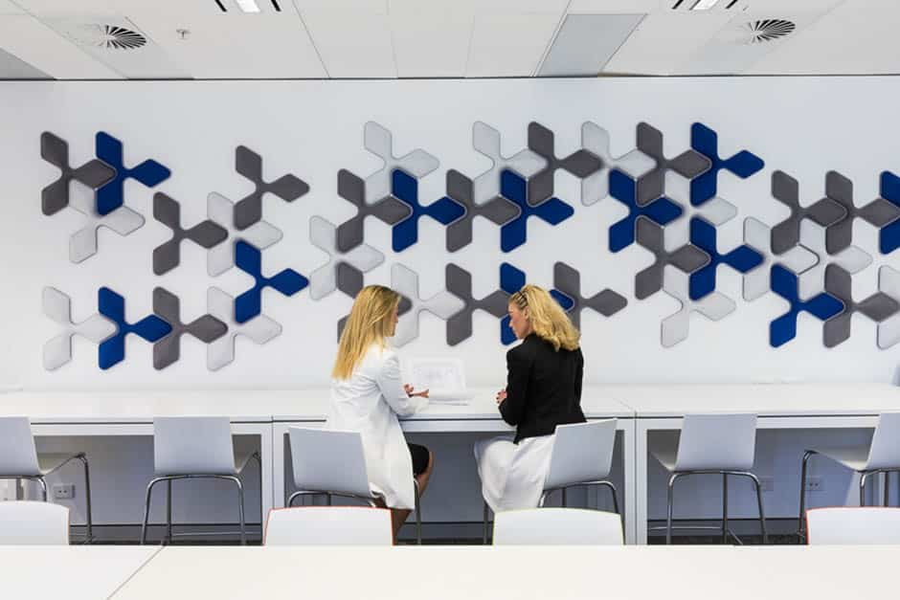
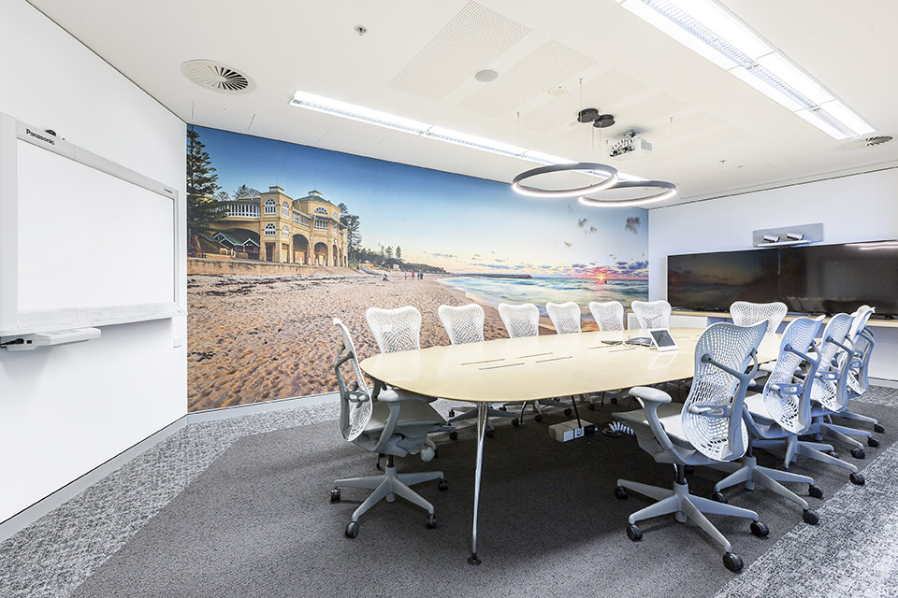
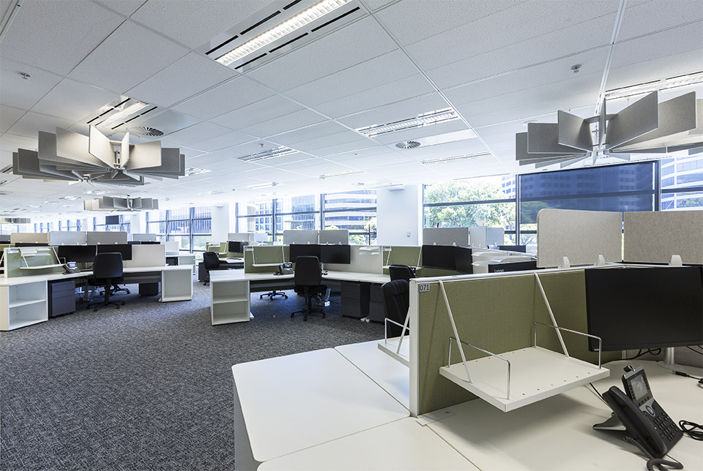

Gallagher
Floor Area: 2300m²
Industry: Insurance

Slide 16
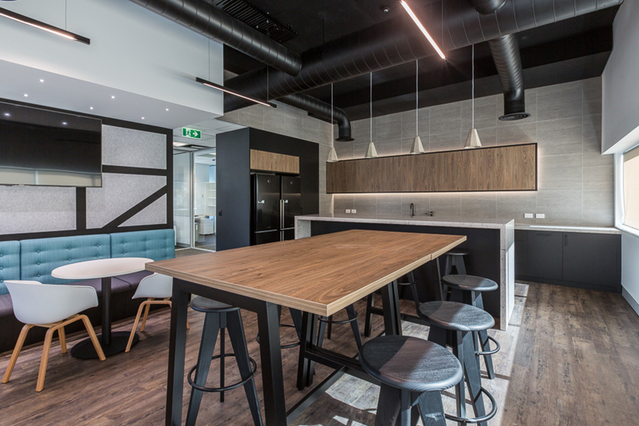
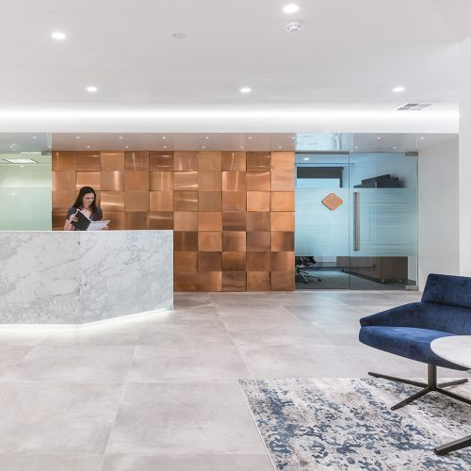
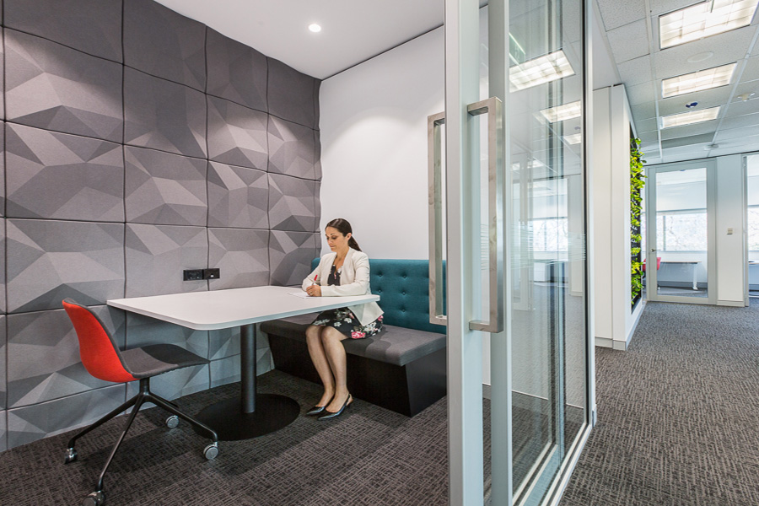
Finance Company
Floor Area: 2400m²
Industry: Finance
FINANCE COMPANY

Slide 17
















Recent Clients

Slide 18
Corporate Responsibility
Safety is paramount in all areas of our business. Wurkspace 7 goal is to ensure no employee, contractor, client or member of the general public is exposed to, or experiences harm from, our work practices.
We have a thorough understanding and adherence policy to the Work Health and Safety Act and legislation and can confirm no breaches in over 7 years.
Insurance
We are comprehensively insured to give you peace of mind
Australian Insurers, Austral Risk Services
Cover
Workers Compensation $50,000,000
Public & Product Liability $50,000,000
Professional indemnity $5,000,000 Capability

Slide 19



Wurkspace 7’s reach across Australia
Melbourne
Sydney
Perth
Brisbane
Contact your local Wurkspace 7 team today.
1800 973 836
www.wurkspace7.com.au transformations@wurkspace7.com.au
ABN: 16127220419

Slide 20


1800 973 836 • www.wurkspace7.com.au

